Slide 1
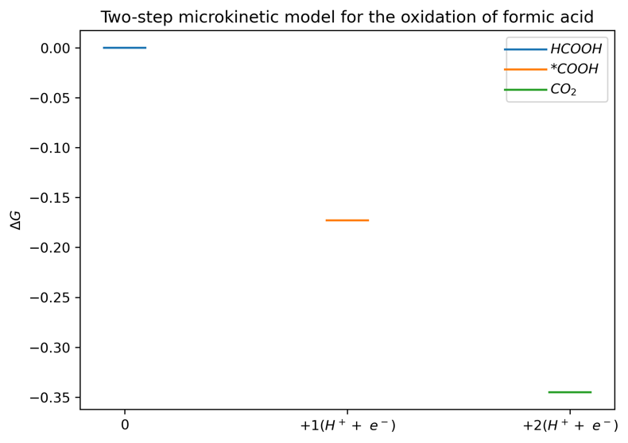

















Optimal formate binding energy
$$0 eV$$
$$U$$
$$ΔG$$
$$ΔG_{COOH^{∗}}^{Optimal}$$
$$2 U$$
$$HCOOH$$
$$COOH^{∗}+(H^{+}+e^{−})$$
$$CO_{2}+2(H^{+}+e^{−})$$
$0 V$ vs. CHE
Too low formate binding energy
$0 V$ vs. CHE
$$0 eV$$
Overpotentiale
$$ΔG$$
$$U$$
$$2 U$$
$$ΔG_{COOH^{∗}}^{Low}$$
$$HCOOH$$
$$COOH^{∗}+(H^{+}+e^{−})$$
$$CO_{2}+2(H^{+}+e^{−})$$
Too high formate binding energy
$$0 eV$$
Over-potential
$$U$$
$$ΔG_{COOH^{∗}}^{High}$$
$$ΔG$$
$$2 U$$
$$HCOOH$$
$$COOH^{∗}+(H^{+}+e^{−})$$
$$CO_{2}+2(H^{+}+e^{−})$$
Notes:
Top:
Maximum U vs CHE that still allows the reaction to happen quickly
Mid:
Too low binding energy, resulting in either a too small U or the energy has to increase from COOH to CO2, making it not go forwards.
Bot:
Too high binding energy, resulting in the U being too small again.
Det laveste potentiale, hvor det går ned ad bakke

